Slide 1
Let’s Talk Mental Health Webinar with Assemblymember Holden May 30, 2024
Elan Shultz
Chief of Policy and Strategy
Los Angeles County Department of Mental Health

Slide 2
DMH – Who We Are and What We Do
Who we serve: DMH serves all residents of Los Angeles County, including residents of all 88 cities*
Populations with unique needs: foster care youth, probation system clients, people experiencing homelessness, school-age youth, justice-involved clients, conservatees, and others
What we do (services we provide/fund):
Prevention/Early Intervention (Promotoras, school-based services, mental health awareness efforts)
Treatment Services (Outpatient, Inpatient, Crisis Residential, Day Treatment)
Crisis Response (988, Field Intervention Teams - PMRT/MCOT, Urgent Care Centers)
Housing and Supported Employment
Public Guardian services (conservatorship processes)
How we do it:
Directly operated services (over 4000 department staff, budget of $3.8B, 183 sites)
Contracted services with CBOs (over $2.2B annually in contracted services, over 950 contracted provider sites)
* Not including the Tri-cities
Notes:
Jen

Slide 3
DMH – Who We Are and What We Do
DMH serves as the Medi-Cal Local Mental Health Plan (MHP) for LA County
An MHP is required to provide or arrange for Specialty Mental Health Services for Medi-Cal members in their County
Specialty Mental Health Services are provided to individuals who require a higher level of mental health care and/or have a more severe mental illness
Managed Care Plans (MCPs) are required to provide services to Medi-Cal members who do not meet criteria for specialty mental health services (e.g. mild to moderate mental illness)
DMH also allocates MHSA funds throughout the County
Notes:
Jen

Slide 4
Recent Changes to MH Field
Increased awareness of importance and how many people are impacted by mental health challenges
Increased focus on people experiencing homelessness who are also experiencing mental illness
Major legislative and Governor-led initiatives:
SB 43 (expands who can be involuntarily committed)
Prop 1 (new bond funds, major changes to ongoing funding streams)
CARE Act (new civil court process for some people with serious mental illness)
CYBHI, BHBH, BHCIP, BH-CONNECT

Slide 5
How DMH Serves People Experiencing Homelessness: Our Approach
Best practice is to meet clients where they are:
DMH has field-based teams that outreach to PEH
For clients who do not feel comfortable and/or have challenges coming into our clinics for services, we bring services to them
For clients who are not yet ready to accept services but clearly need treatment we provide relentless engagement to offer them services
Clients often have a wide variety of service needs, so we offer holistic programs (often with services partners)

Slide 6
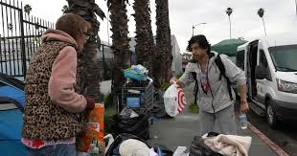
Special Programs for People Experiencing Homelessness w/ Severe Mental Illness
Homeless Outreach & Mobile Engagement (HOME)
Veterans Peer Access Network (VPAN)
Hollywood 2.0
Skid Row Concierge
Interim Housing Outreach Program (IHOP)
Preventing Homelessness and Promoting Health (PH²)
Specialized Program Funding
MHSA
Medi-Cal
PATH/SAMHSA
FY 2023-24 Budget $108.4 million

Slide 7
Proposition 1 Behavioral Health Services Act (Formerly SB 326)
Biggest Changes:
Requires counties to provide new Substance Use Disorder (SUD) services to SUD-only populations, no additional funding will be added
New housing category: Includes, but not limited to, rental subsidies, operating subsidies, shared housing, family housing​. Does NOT include mental health services and supports.
State retains more funding and will take on some of the funding for prevention, workforce development that counties now receive funding for
New requirement for counties to do much more robust planning, monitoring, reporting. State must approve counties’ plans for all behavioral health funds.
Programmatic changes will begin July 1, 2026. Administrative funding for the new community planning process will begin January 2025.

Slide 8
Estimated BHSA Expenditure Shifts
BHSA Comparison: Estimated Dollar Impact w/ State Share
Category | Current Expenditure | Future Allocation | Difference
Full Service Partnerships | $106,806,000 | $196,401,000 | $89,595,000
Housing | $44,985,000 | $161,329,000 | $116,344,000
Early Intervention | $21,103,000 | $175,288,000 | $154,185,000
Other | $176,969,000 | - | ($176,969,000)
Core Services | $392,393,000 | $168,414,000 | ($223,979,000)
State | $37,113,000 | $77,937,000 | $40,824,000
Total | $779,369,000 | $779,369,000 | -
*Based on three-year revenue average FY 20-21 to FY 22-23. Does not reflect shift to prudent reserve or SUD only expenditures

Slide 9
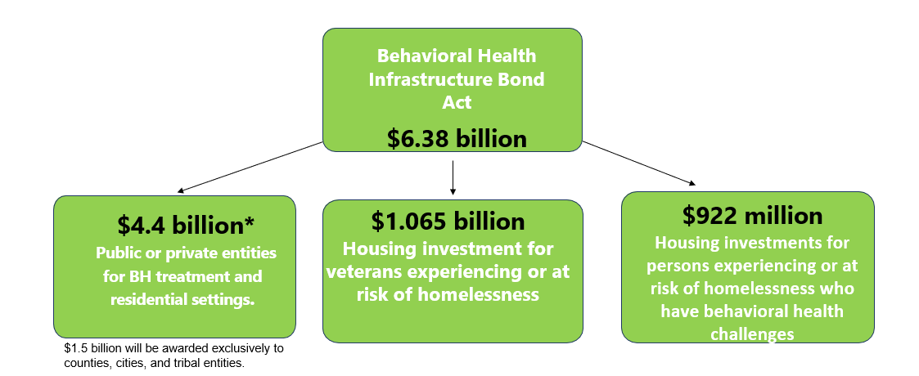
Prop 1 Bond Funding
In March 2024, California voters passed Proposition 1, that includes the Behavioral Health Services Act (Senate Bill 326) and the Behavioral Health Infrastructure Bond Act (BHIBA) of 2024 (Assembly Bill 531), authorizing the State to make additional grant funding available to eligible entities.
The BHIBA is a $6.38 billion general obligation bond to develop a wide range of behavioral health treatment, residential care settings, and supportive housing to help provide appropriate care facilities for Californians experiencing mental health conditions and substance use disorders.

Slide 10
SB 43 Changes “Grave Disability”
Current definition of grave disability:
Welfare and Institutions code section 5008 (h)(1) (A) defines the term “gravely disabled” as a condition in which a person, as a result of a mental disorder or chronic alcoholism, is unable to provide for his or her basic personal needs for food, clothing, or shelter.
New definition of grave disability under SB 43:
A condition in which a person, as a result of a mental health disorder, a severe substance use disorder or a co-occurring mental health disorder and a severe substance use disorder, is unable to provide for their basic personal needs for food, clothing, shelter, personal safety or necessary medical care

Slide 11
Implications of SB 43
Capacity challenges expected throughout the LPS system
Expectation for more people to be placed on involuntary holds
Expectation for more people to be placed on longer holds
Expectation that lack of capacity for involuntary SUD care will increase strain on LPS settings
There are no facilities that are currently licensed to provide involuntary SUD care
Data does not demonstrate that SUD treatment can be successfully provided on involuntary basis

Slide 12
CARE Court
CARE was successfully implemented in Los Angeles County on December 1, 2023.
Regional offices were established in each of the eight (8) Service Areas.
The CARE process is a voluntary Civil Court proceeding which is collaborative and supportive in its approach.
The court proceedings are held at the Norwalk Courthouse, which also includes a legal self-help center.

Slide 13
CARE Court Metrics – as of May 20th, 2024
Total petitions filed = 145
Family Initiated Petitions: 137
Non-Family Initiated Petitions: 4
Prototypes – 1
Hope the Mission – 2
Tarzana Treatment Center - 1
DMH Initiated Petitions: 4
Hearings Scheduled to Date: 97

Slide 14
CARE Court Metrics – as of May 20th, 2024
Total Petitions Dismissed = 30 (out of 145)
Incarcerated: 3
Moved Out of County: 1
Does not Meet CARE Criteria: 6
Unable to Locate Client: 1
Client Already in Treatment: 19
Housing Status
Housed: 94
Not Housed: 44
Justice System: 6
Hospital: 1

Slide 15
CARE Court Outcomes – as of May 20th, 2024
Ten (10) CARE Agreements
One (1) CARE Plan
Outreach & Linkage (as of 5/20/2024):
Self-help Calls – 61
Face to Face Consults at Court – 95
Community Contacts – 535
Some clients referred to FSP, to outpatient clinics, reconnected with family, into hospitals, to the public guardian

Slide 16
Resources – Who to Call
988 = The new crisis hotline number. Connects caller to trained crisis counselors who can provide immediate support.
LACDMH’s Help Line is available 24/7 to provide mental health support, resources and referrals at (800) 854-7771 (crisis and non-crisis)
For more information about mental health resources:
https://dmh.lacounty.gov/resources
For more information about CARE Court:
https://dmh.lacounty.gov/court-programs/care-court/

Slide 17
Resources – Who to Call

Slide 18
Questions?

