Slide 1
NAMI San Gabriel Valley
supporting our community with no cost programs for more than forty years
NAMI San Gabriel Valley is an affiliate of NAMI Greater Los Angeles County

Slide 2
Who We Are

Slide 3
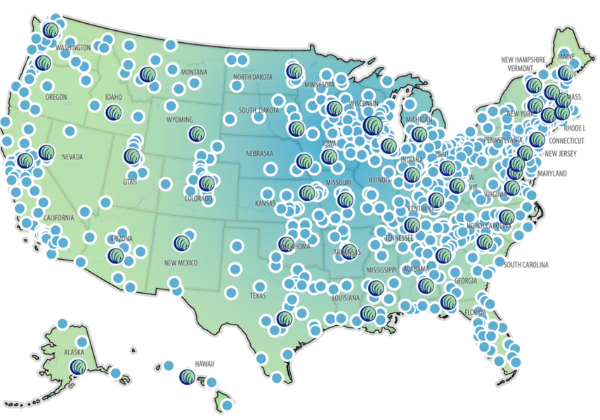
Who We Are
The National Alliance on Mental Illness (NAMI) is the nation’s largest grassroots mental health organization dedicated to building better lives for the millions of people affected by mental illness.
What started as two mothers gathered around a
kitchen table in 1979 has blossomed into the nation’s
leading voice on mental health. Today, NAMI is an
alliance of more than 600 local Affiliates and 49 State Organizations who work in your community to raise awareness
and provide support and education that was not previously
available to those in need.

Slide 4
Who We Serve
We serve individuals and families affected by mental illness, and all interested community members through our education and outreach.
NAMI SGV is responsible for programs and support in San Gabriel Valley.
Anyone may participate in NAMI San Gabriel Valley programs no matter where they live.
Membership in NAMI is not required to participate our programs.
Our programs are offered free of charge as a community service.

Slide 5
What We Do
We offer support groups for individuals and families affected by mental illness.
We offer 8-week classes for families and individual affected my mental health challenges.
We have a Help Line telephone team to help with resources and listen with empathy.
We sponsor outreach programs to community and school groups, hospitals and more.
We host lectures and education programs, and support NAMI On Campus clubs.
We host Quality of Life activities for residents of local board and care homes.
We advocate for better conditions for people affected by mental illness.

Slide 6
Support Groups
By sharing your experiences in a safe setting, you can gain hope and develop supportive relationships.
NAMI’s support groups are unique because they follow a structured model to ensure you and others in the group have an opportunity to be heard and to get what you need.
Free of cost to participants
No specific medical therapy or treatment is endorsed
Confidential

Slide 7
Support Groups
NAMI Connection is a peer-led support group for any adult who has experienced symptoms of a mental health condition.
NAMI Family Support Group is for family members, significant others and friends of people living with a mental illness. Support Groups are facilitated by family members of people with mental health conditions.

Slide 8
NAMI 8-week classes
NAMI Peer-to-Peer is a free, eight-session educational program for adults with mental health conditions who are looking to better understand themselves and their recovery. Taught by trained leaders with lived experience, this program includes activities, discussions and informative videos.
NAMI Family-to-Family is a program for family, significant others and friends of people with mental health conditions. This course is designed to help participants gain a better understanding of mental health conditions, improve their coping skills and empower them to advocate for their loved one.

Slide 9
NAMI Outreach Presentations
NAMI Ending the Silence is an engaging presentation that helps middle and high school aged youth learn about the warning signs of mental health conditions and what steps to take if you or a loved one are showing symptoms of a mental health condition.
NAMI In Our Own Voice presentations are free, 40-, 60- or 90-minute presentations that provide a personal perspective of mental health conditions, as leaders with lived experience talk openly about what it's like to have a mental health condition.

Slide 10
Resources
Our NAMI San Gabriel Valley website has substantial resources and information about mental health conditions. https://namisangabrielvalley.org
Our Help Line telephone team can help callers find helpful resources. 626-577-6697
Our Resources webpage is organized into three sections:
Major topics of interest (information frequently requested by help line callers)
Mental Illness Facts and Resources (information on mental health conditions and related resources)
More Information and Resources (books, videos, additional subjects and organizations)

Slide 11
Getting Help/Getting Involved
Request an outreach presentation for your child’s school or a community group.
Join our volunteer teams.
Share your story.
Participate in our programs.
Advocate.

Slide 12
Spreading the Word
We hope you will let others know that NAMI is here when they need us. NAMI is the only organization that provides family support programs like ours, and people need to know they are not alone. There are NAMI affiliates across the county, the state, and the nation.
We hope you’ll listen to inspiring personal testimonies of people who have a mental illness by visiting “Books and Videos” in our Resources webpage and share those stories when you meet someone who needs help and hope.
We hope you’ll let others know about the local resources and information available at our website, and the support groups and classes we offer.

Slide 13
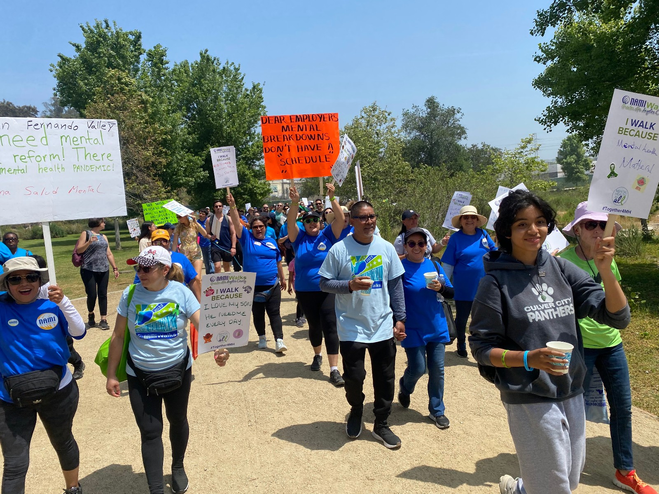
NAMI Walks – May 4, 2024
Support NAMI during our largest yearly fundraiser-NAMI Walks. Donations accepted through July 4, 2024.

Slide 14
Contact NAMI San Gabriel Valley
Visit our website for contact information, resources, programs, calendar, and opportunities to get involved. https://namisangabrielvalley.org
626-577-6697 or 818-928-2813
sgvnami@pacificclinics.org
sgil@namiglac.org

Slide 15
Thank You

